Slide 1

CANDEV Data Challenge
Flying Tigers
– Fan Yang

Slide 2
Employment and Social Development Canada (ESDC) Analysis
Indicators Analysis
Trends of diversification for each occ group

Slide 3
Indicators of workforce diversification
Manager group diversification
Salary group diversification
Hire diversification in occ groups
Promotion diversification in occ groups
Terminated diversification in occ groups

Slide 4
Indicator Founding
Managers group diversification has the highest correlation with overall diversification
There overall diversification has highest correlations with the top salary group(above $60,000, which is managers salary) and the bottom salary group(below $17,499)
The highest correlation with overall hires diversification is the Skilled Sales and Service
The highest correlation with overall promotion diversification is Senior Managers, and Skilled Sales and Service
The highest correlation with overall terminated diversification is Skilled Sales and Service
The achieved rate of each group for companies in 2019 was below 13%, except for groups that are involved much more men than women such as Skilled Crafts and Trades Workers
*Achieved rate is based on 2016 LMA Women/Men ratio plus and minus 10%

Slide 5
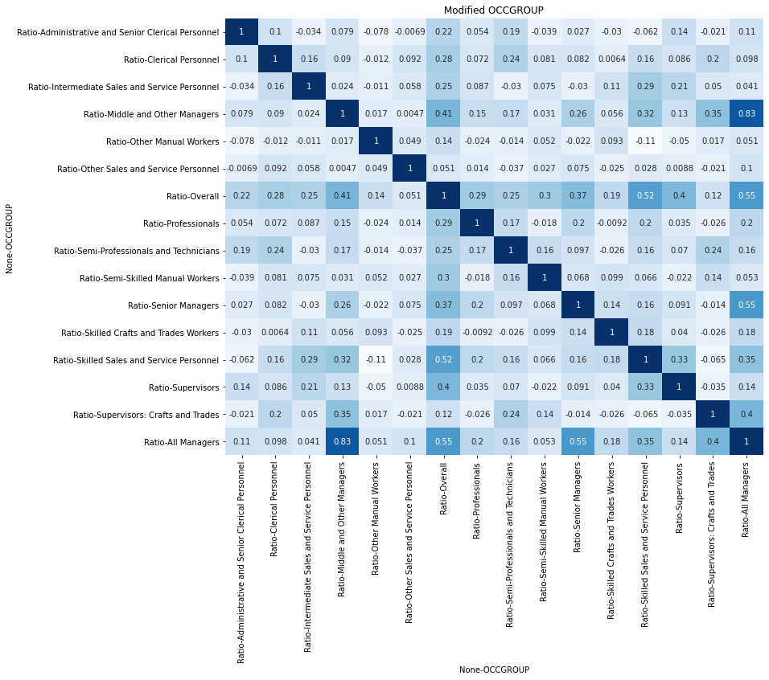
Correlation Map of Managers group with overall diversification

Slide 6
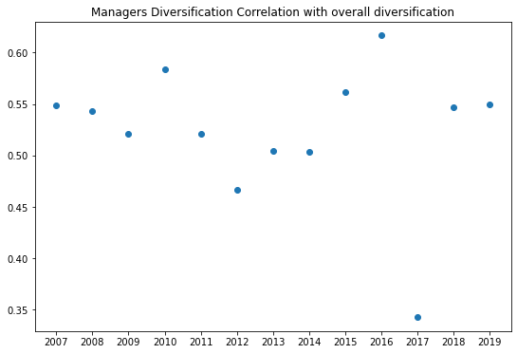
Managers & overall correlation Trends
The Managers & Overall correlation has no clear pattern of changing over the years.
Meaning there's a constant correlation between the two.
We can be sure that Managers diversification is an important indicator and is highly related with the overall diversification.

Slide 7
Trend Founding
Managers group achieved rate has been increasing over the years, meaning we are doing better and better achieving Managers level diversification (More men than women)
Skilled Sales and Service achieved rate is increasing over the years (more women than men)
Semi-Professionals and Technicians rate is increasing over the years (more men than women)
Supervisors seems has a pattern of increasing over the years (more women than men)
Semi-Skilled Manual Workers has an increasing pattern (More men than women)
Intermediate Sales and Service Personnel has a pattern of increasing (more women than men)
Professionals achieved rate was dropping and then improving since 2015
Administrative and Senior Clerical Personnel seems have a pattern of decreasing (more women than men)
Clerical Personnel has a pattern of decreasing (more women than men)
Supervisors: Crafts and Trades does not have a clear pattern
Skilled Crafts and Trades Workers has no clear pattern
Other Sales and Service Personnel has no clear pattern
Other Manual Workers has no clear pattern

Slide 8
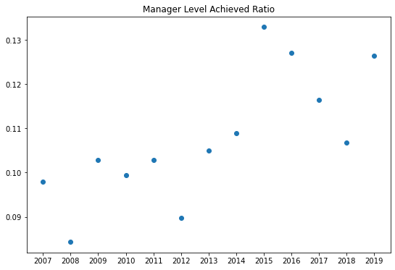
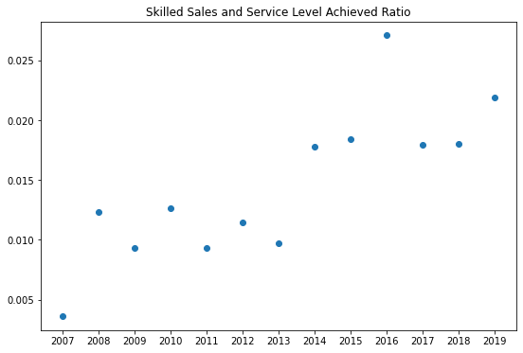
Appendix

Slide 9
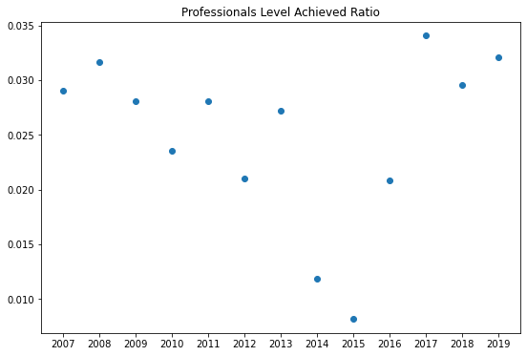
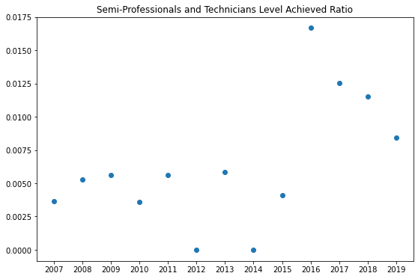
Appendix

Slide 10
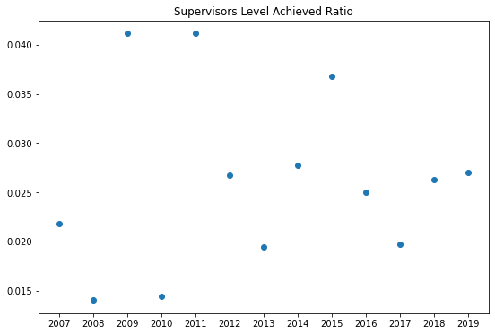
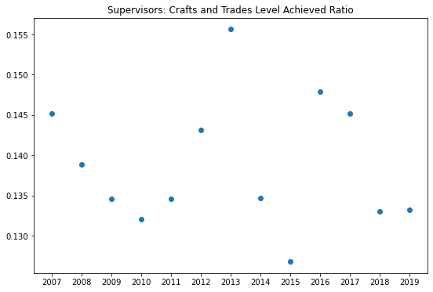
Appendix

Slide 11
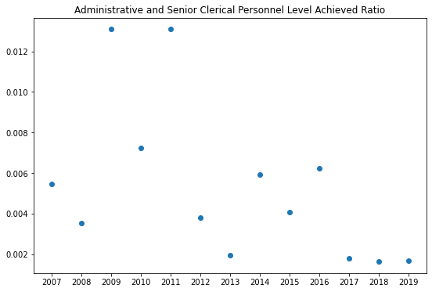
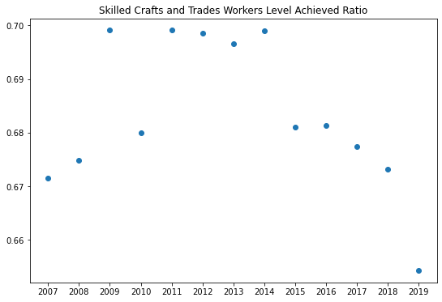
Appendix

Slide 12
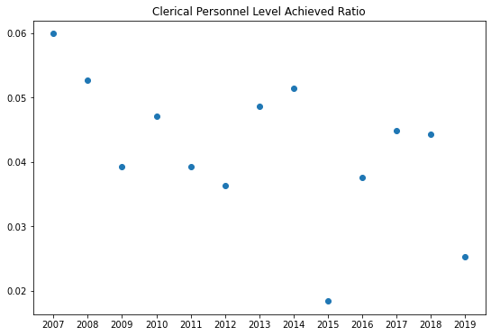
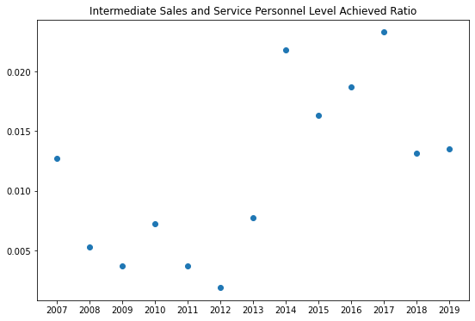
Appendix

Slide 13
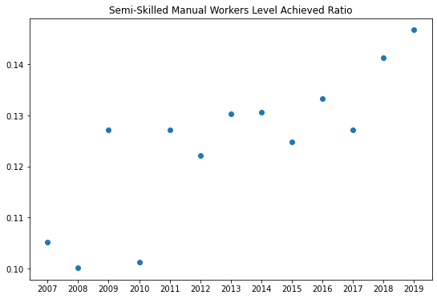
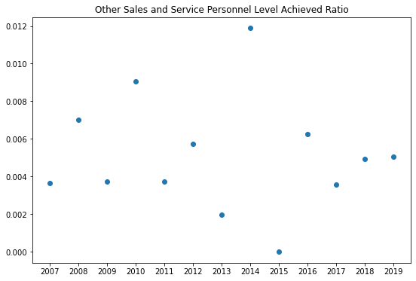
Appendix

Slide 14
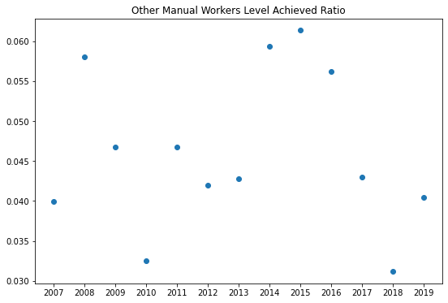
Appendix

Slide 15
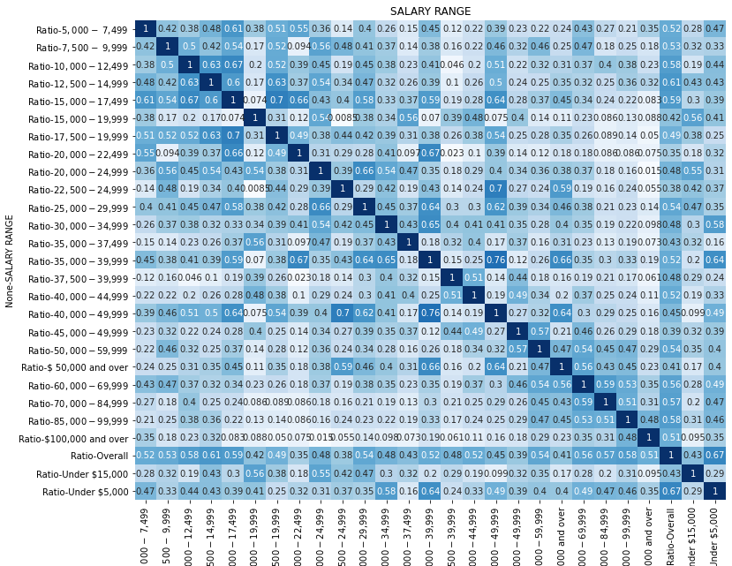
Appendix

Slide 16
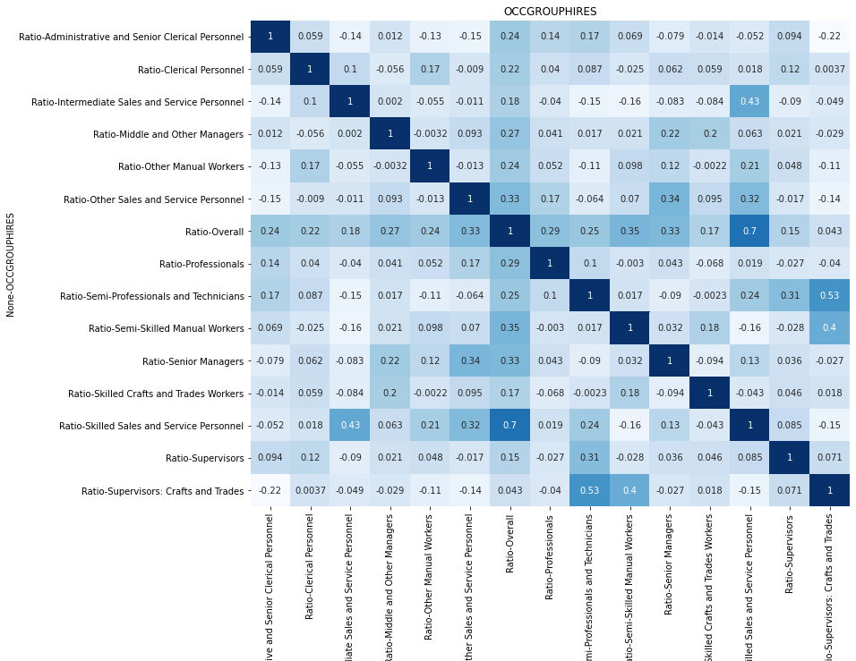
Appendix

Slide 17
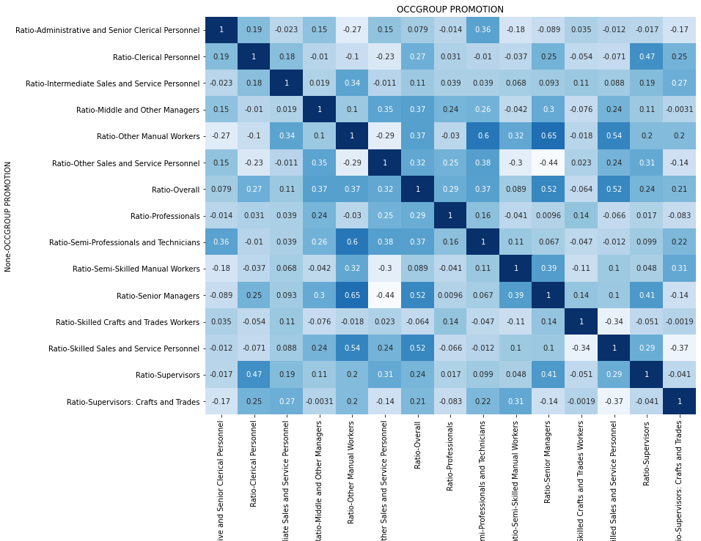
Appendix

Slide 18
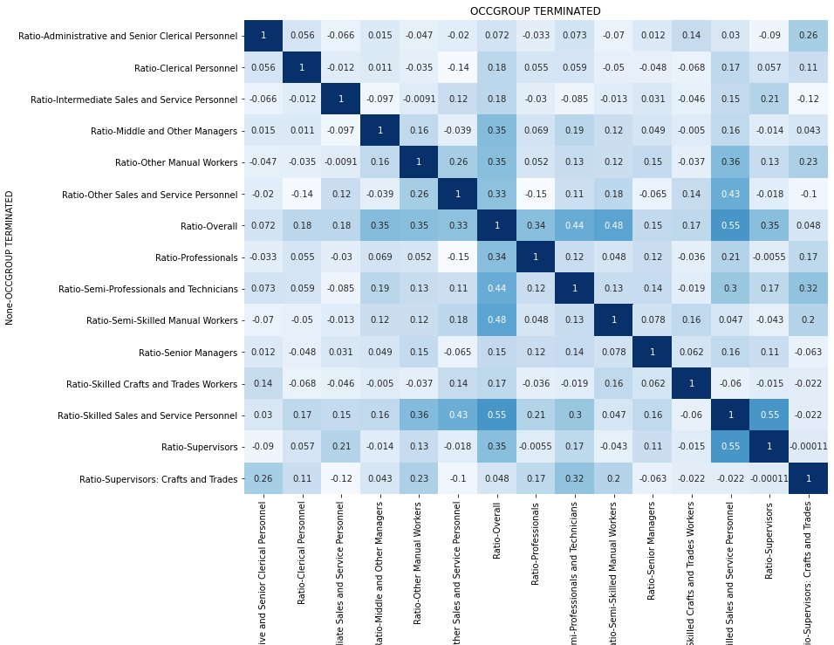
Appendix

Slide 19
Appendix
Achieved rate for each group in 2019
Overall achieved percent: 5.90%
All Managers achieved percent: 12.65%
Professionals achieved percent: 3.20%
Semi-Professionals and Technicians achieved percent: 0.84%
Supervisors achieved percent: 2.70%
Supervisors: Crafts and Trades achieved percent: 13.32%
Administrative and Senior Clerical Personnel achieved percent: 0.17%
Skilled Sales and Service Personnel achieved percent: 2.19%
Skilled Crafts and Trades Workers achieved percent: 65.43%
Clerical Personnel achieved percent: 2.53%
Intermediate Sales and Service Personnel achieved percent: 1.35%
Semi-Skilled Manual Workers achieved percent: 14.67%
Other Sales and Service Personnel achieved percent: 0.51%
Other Manual Workers achieved percent: 4.05%

